Slide 2
What is data visualization?
Data Visualization is an art of presenting the data in a manner that even a non-analyst can understand it.
A perfect blend of aesthetic elements like colors, dimensions, labels can create visual masterpieces, hence revealing surprising business insights which in turn helps businesses to make informed decisions.
Data Visualization is an inevitable aspect of business analytics. As more and more sources of data are getting discovered, business managers at all levels embrace data visualization software, that allow them to analyze trends visually and take quick decisions.

Slide 3
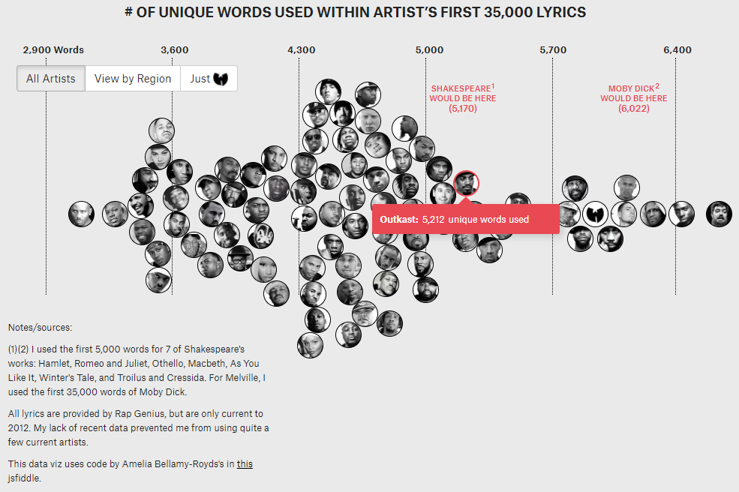
THE LARGEST VOCABULARY IN HIP HOP
Visualization by: Matt Daniels
Notes:
Literary elites love to rep Shakespeare’s vocabulary: across his entire corpus, he uses 28,829 words, suggesting he knew over 100,000 words and arguably had the largest vocabulary, ever.
I decided to compare this data point against the most famous artists in hip hop. I used each artist’s first 35,000 lyrics. That way, prolific artists, such as Jay-Z, could be compared to newer artists, such as Drake.

Slide 4
What is Tableau?
Tableau was founded in 2003 as a result of a computer science project at Stanford that aimed to improve the flow of analysis and make data more accessible to people through visualization.
Tableau's patented foundational technology, VizQL— visually expresses data by translating drag-and-drop actions into data queries (think SQL) through an intuitive interface.
Tableau was acquired by Salesforce in 2019
https://www.tableau.com/learn/articles/best-data-visualization-blogs

Slide 5
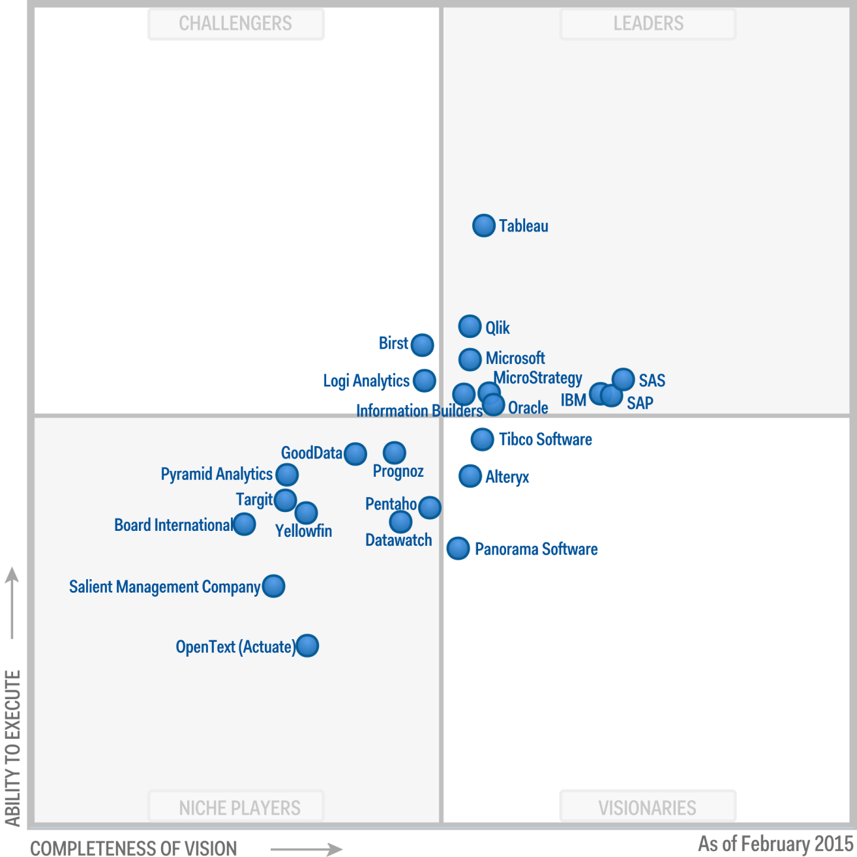
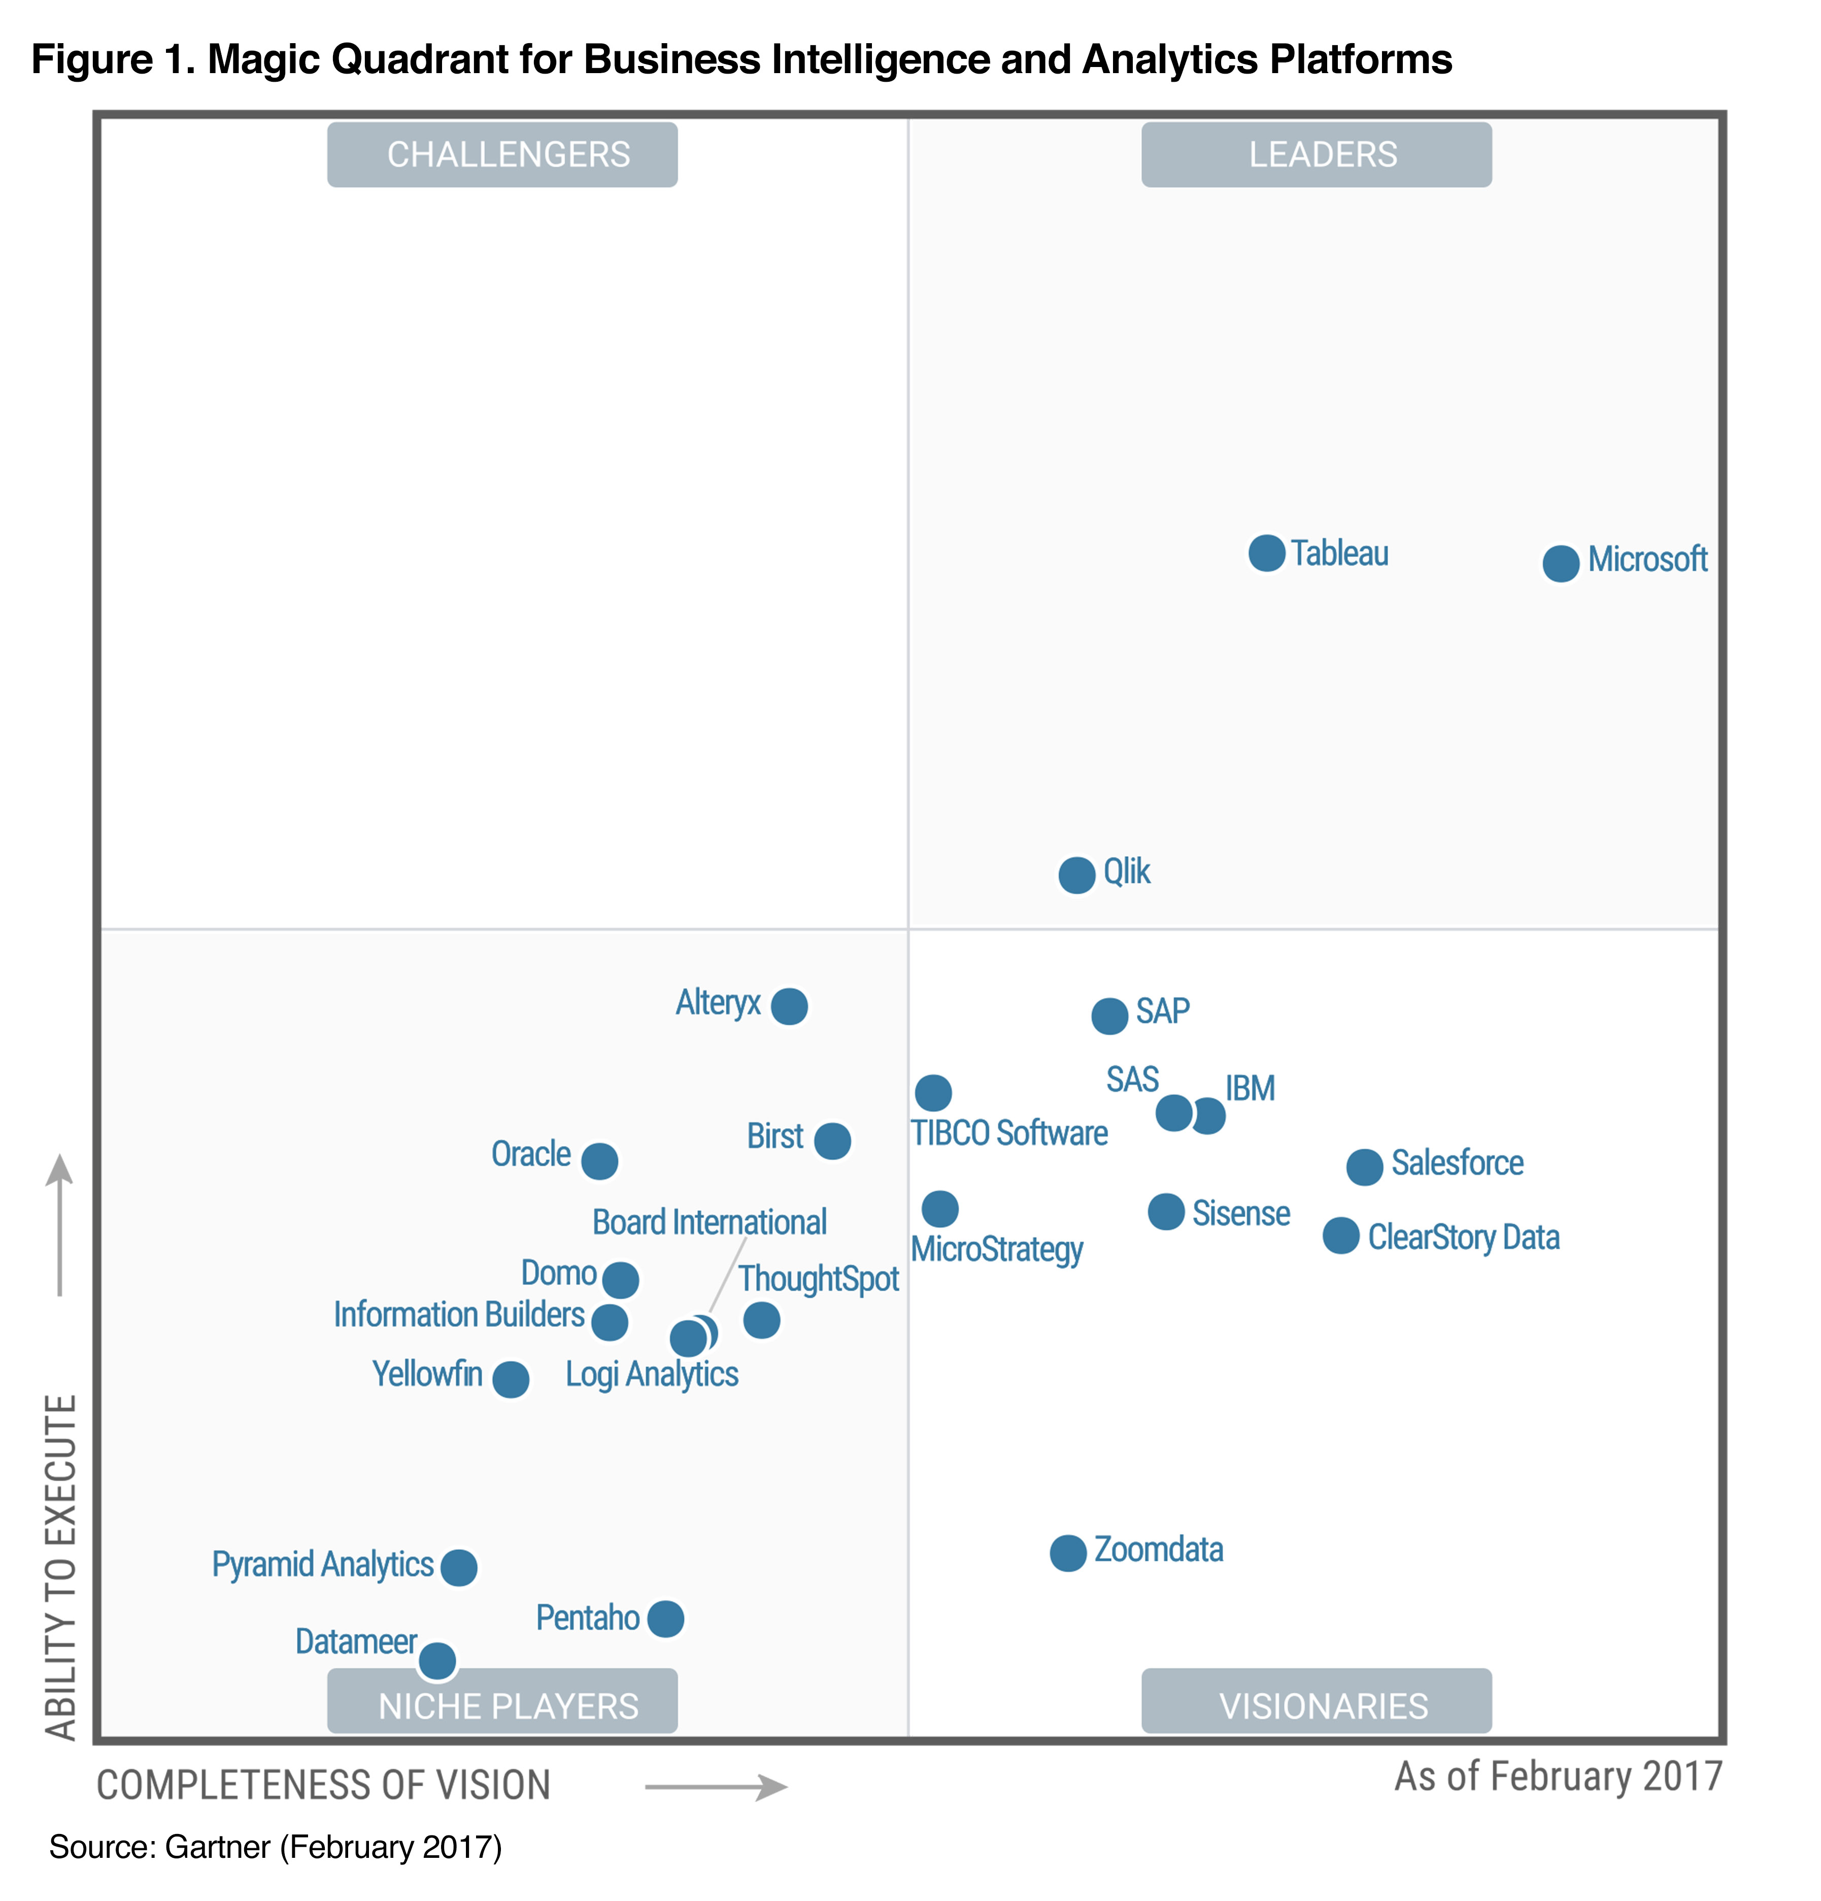
Tableau is a Market Leader
Tableau is a Leader in this Magic Quadrant. Here you’ll see a number of key players in the drag-and-drop / visual space
In 2015, Tableau led the market. In 2017 Microsoft enhanced their capabilities, creating greater competition
Notes:
Tableau is a Leader in this Magic Quadrant. It offers a visual-based exploration experience that enables business users to access, prepare, analyze and present findings in their data. It has powerful marketing and expanded enterprise product capabilities, but the integration of Salesforce Einstein Analytics, now renamed Tableau CRM, remains a work in progress.
In 2020, Tableau enhanced its data preparation and data management capabilities. For data preparation, it released enhanced data modeling capabilities, which make it easier to analyze data across multiple tables at different levels of detail by building relationships between tables with a simple in-browser visual experience. For data management, Tableau Prep Conductor and Tableau Catalog offer a cohesive experience for operating and automating data management and understanding data lineage. An Einstein Discovery dashboard extension, the first integrated product to bring the predictive modeling capabilities of Salesforce Einstein Analytics to the Tableau platform, is scheduled for release in March 2021.

Slide 6
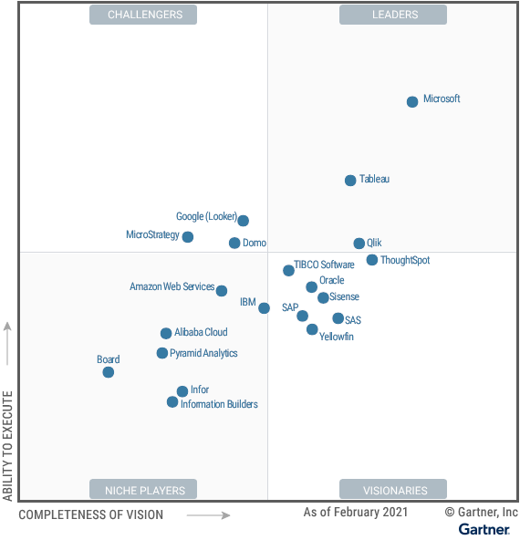
What do people love about Tableau?
In 2020, Tableau enhanced its data preparation and data management capabilities.
A sleek experience for users to perform analysis seamlessly
Many customers are “fans”
A user-experience-focused design
A perfect “bridge to BI” from Excel/Spreadsheet tools
Notes:
StrengthsAnalytics user experience: Although Tableau keeps adding new capabilities, it always maintains a sleek experience for users, so they can perform analysis seamlessly. Although visual-based exploration is highly commoditized in today’s market, Tableau can still differentiate itself by offering an intuitive analytics experience with richer capabilities based on its patented VizQL engine.
Customer enthusiasm: Many customers demonstrate a fanlike attitude toward Tableau, as evidenced by the more than 145,000 people who attended its 2020 online user conference. Tableau Public, a free platform on which to publicly share and explore data visualizations online, has over 3 million interactive visualizations. A user-experience-focused design means that, particularly for users in analyst roles, Tableau’s offering is compelling and even enjoyable to use.
Salesforce opportunity: The Tableau Viz Lightning web component offers a low-code experience to simplify the task of integrating Tableau visualizations into Salesforce. Work.com, Salesforce’s cloud offering to help organizations reopen workplaces safely and efficiently, uses the Tableau Viz Lightning web component to add a global COVID-19 tracker dashboard to the Workplace Command Center. The deeper integration of the MuleSoft data connector capabilities and a newly acquired Slack collaboration tool means that Salesforce clients have a strengthening set of reasons to consider Tableau.
CautionsNot cloud-native: Tableau offers cloud-hosted solutions (Tableau Online and Tableau CRM), but the company’s heritage is in on-premises deployments, for which it has a massive installed base. Tableau does not have a cloud-native architecture for on-premises customers to embrace the cloud’s full benefits. Deployment of Tableau Server in a containerized infrastructure is not currently supported (but is planned for 2021). As such, beyond Tableau Online, it cannot utilize the cloud’s elasticity to automatically scale out in order to handle dynamic workloads.
Premium pricing: Tableau’s pricing is an issue raised by users of Gartner’s client inquiry service. Compared with some of the cloud vendors in this market, Tableau is expensive. The addition of Tableau CRM for a list price of up to $150 per user per month may well increase the concern of customers who are considering scaling their deployments or acquiring new functions.
Integration challenges: As is to be expected, the integration of Salesforce’s ABI capabilities with those of Tableau is taking time. Currently, users face a fragmented experience if they want to take advantage of the augmented analytics functions of the former Einstein Analytics while using the Tableau platform. Einstein Analytics’ strengths in automated data stories, key driver analysis, custom automation and explainable AI are not yet integrated into the Tableau user experience.

Slide 7
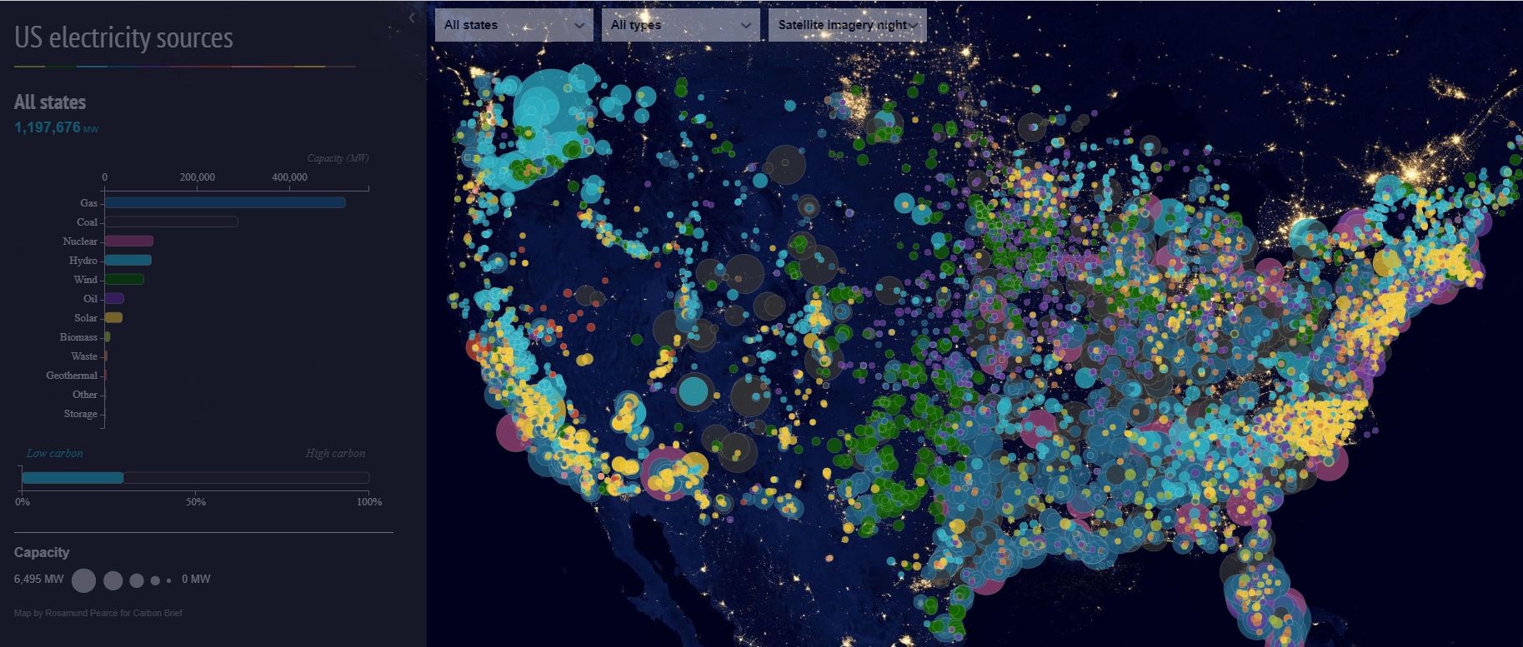
US Electricity Sources
Visualization by: Justin Davis
Notes:
Using data from the US Bureau of Labor Statistics, another Tableau Public “Viz of the Week” by Justin Davis, demonstrates the percentage of all US hourly workers that earn minimum wage or less. Each map in the set of small multiples provides a yearly snapshot of minimum wage workers going as far back as 2002. When you hover over a state, the percentage of workers for that area is noted and looking year-by-year, state-by-state you can see if there is an upward or downward trend.

Slide 8
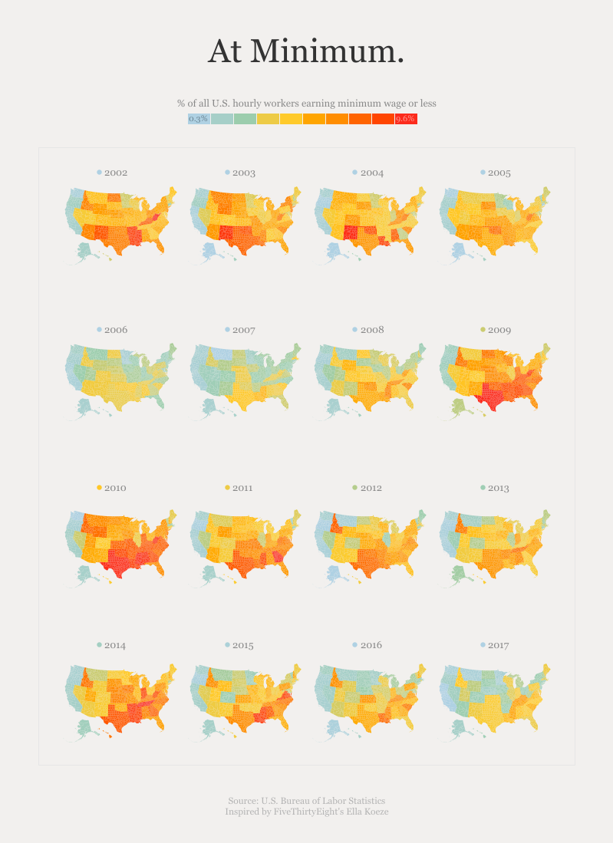
U.S. Workers at or Below Minimum Wage
Visualization by: Simon Evans and Rosamund Pierce
Notes:
When turning on a light, you don’t necessarily think about the power source behind it. This interactive, colorful map details exactly where the United States’ electricity comes from and how much energy is generated. Each circle represents an individual power source, which are color-coded by type, with the source key demonstrating total capacity nationwide. The circle size also indicates the power output generated by the source.

Slide 9
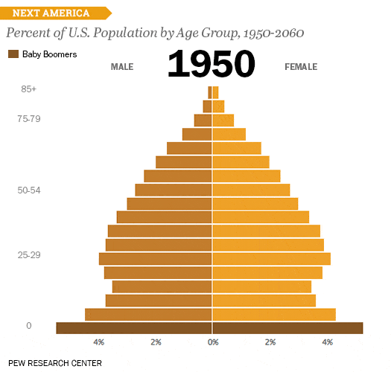
The Next US
Visualization by: Pew Research Center Learn more: Next America
Notes:
Pew’s The Next US takes a comprehensive look at demographic data in the United States and brings it all together into a massive, interactive, beautiful data visualization project with several “chapters” of pointed visualizations (above is just one). This project displays things like growing diversity and interracial marriage trends, provides historical contexts to trend lines, and takes guesses at the projected demographic shifts and changes that the US might undergo in the coming decades.
One highlight is an animated age and gender demographic breakdown pyramid. In a few seconds, we can see how population demographics have shifted since the 1950s, with medical intervention and healthcare keeping people alive longer and birth rates decreasing after the post-WWII baby boom. As time progresses, the age pyramid turns into a rectangle.

Slide 10
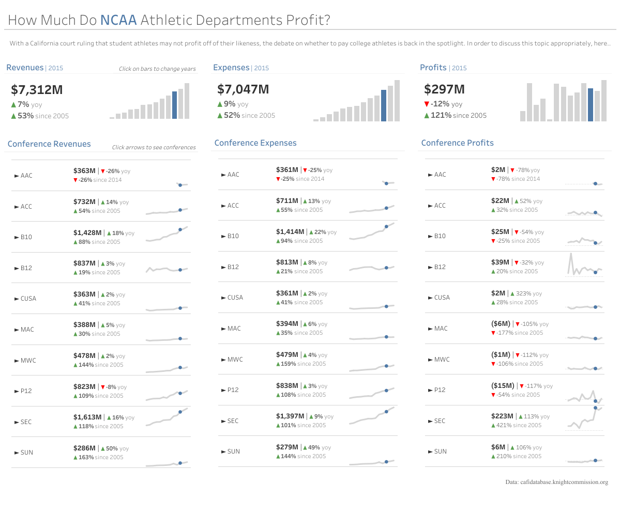
NCAA Profits KPI Dashboard
Visualization by: Spencer Baucke
Notes:
With a California court ruling that student-athletes may not profit off their likeness, the debate continues to pay or not to pay college athletes. Here Spencer Baucke breaks down athletic department profits and losses from 2005-2017 in a KPI-style dashboard that allows the viewer to quickly come to insights.
https://public.tableau.com/en-us/s/blog/2020/10/ten-most-favorited-vizzes-celebrate-ten-viz-tastic-years-tableau-public

